Slide 1

Attire Fit-In
INSTITUTE OF ENGINEERING AND TECHNOLOGY, LUCKNOW
DEPARTMENT OF COMPUTER SCIENCE & ENGINEERING
Submitted By:
Rishabh Balaiwar (1805210042)
Nishtha Shukla (1805232038)
Himani Srivastava (1805232026)
Submitted To:
Dr. Upendra Kumar
Ms. Deepa Verma
Notes:
Nishtha

Slide 2
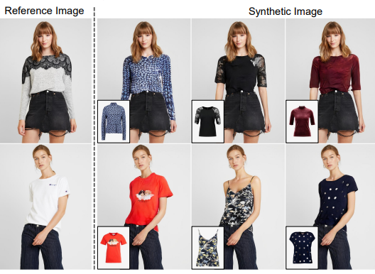
Table of Contents
Problem Statement
What is a Virtual Try-On?
Dataset
Methodology
Implementation
Application
Limitations
Conclusion
References

Slide 3
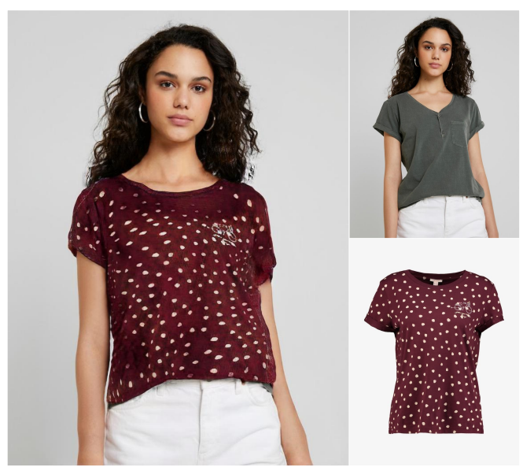
Problem Statement
We aim to build a virtual try-on, ‘Attire Fit-in’, which would help people visualize how a particular piece of clothing would look on them. Our model would generate a synthetic image of the client trying the clothing item.
For the use of this project in everyday life, we can deploy it at shopping malls to help people understand how the clothes would look on them without physically trying them on. It would be beneficial when people maintain social distancing in extraordinary situations like the COVID-19.

Slide 4
What is Virtual Try-On
Image-based virtual try-on basically refers to the image generation task of changing the clothing item on a person into a different item, given in a separate product image.
Virtual try-on is similar to image synthesis, but it brings with it certain aspects that need to be looked after in order to provide a satisfactory experience to the user.
Provided the image of the client and the garment they need to try, the synthesised output image must preserve:
(1) The clients’ pose, body shape, and identity.
(2) Natural deformity in the clothing product in accordance with the desired clothing region of the given person, by reflecting his/her pose and body shape.
(3) Intricacies of the clothing product.
In this era of online shopping, virtually trying on the clothes would enhance a customer’s experience, providing the customer an idea about what look would it give on them.

Slide 5
Dataset
13,679 frontal-view women and top clothing image pairings were collected from an online shopping mall website.
The complete pair set was broken into training and test set of 11,647 and 2,032 pairs, respectively.

Slide 6
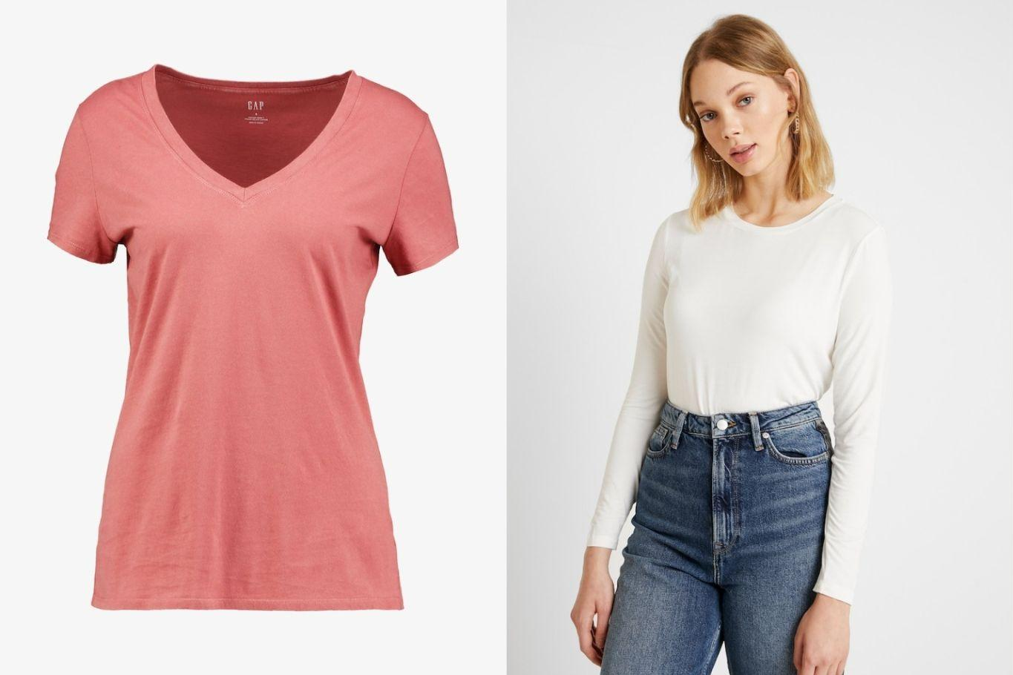

Slide 7
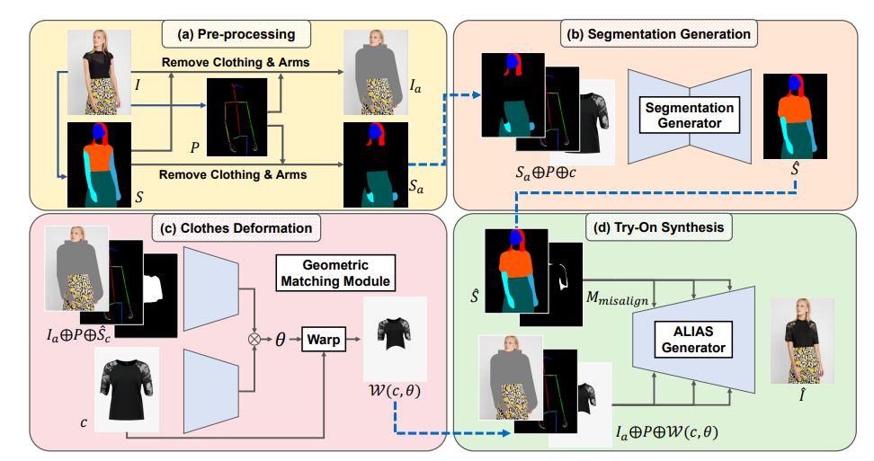
Methodology

Slide 8
PHASE 1: Pre-Processing
It is the first step of the try-on model.
Given a reference image, I, containing a target person, we predict the segmentation map S and the pose map P.
A segmentation map is used to remove the clothing region to be replaced and preserve the rest of the image.
A pose map is utilized to remove the arms only.
We generate the clothing agnostic image I_{a} and the segmentation map S_{a} using S and P.
Using I_{a} and S_{a}, the model thoroughly removes the original clothing information and preserves the rest of the image.

Slide 9
PHASE 2: Segmentation Generator
The segmentation generator consist of convolution layers, downsampling layers and upsampling layer.
Downsampling layer is a pooling layer responsible for the reducing the spatial dimensions of the image.
Upsampling layers is a version of an unpooling or opposite of pooling layer.
Segmentation generator predicts the segmentation map S^.
The segmentation map maps the person in the reference image wearing the target clothing.

Slide 10
PHASE 3: Clothing Image Deformation
In this phase the target clothing item c is deformed to align it with ^S_{c}, which is the clothing area of ^S.
A correlation matrix will be generated between the features retrieved from (I_{a}, P) and c.
The regression network predicts the TPS transformation parameters using the correlation matrix as input, and then c will be warped by.

Slide 11
PHASE 4: Try-On Synthesis via Alias Normalization
This phase generates the final synthetic image ^I based on the outputs from the previous stages
At this stage, intention is to combine the clothing-agnostic human representation (I_{a}, P) and the distorted clothing picture W(c, θ)
Each layer of the generator is injected with (I_{a}, P, W(c, θ))
ALIAS normalisation allows for the preservation of semantic information as well as the elimination of misleading information from misaligned regions.
ALIgnment-Aware Segment (ALIAS) normalisation is a conditional normalisation method .
Three convolution layers and three ALIAS normalisation layers make up each ALIAS residual block.
The inputs of the normalisation layers, are adjusted before injecting them into each layer as residual blocks function at various resolutions. Similarly, the generator's input is resized to various resolutions.
The resized inputs are concatenated to the activation of the previous layer, and each residual block uses the concatenated inputs to refine the activation.
Thus multi-scale refinement at a feature level is achieved.

Slide 12
Implementation Details
With the goal of reconstructing I from (Ia, c), the training of each stage proceeds individually.
In the pre processing stage we generate the clothing-agnostic image Ia and remove the arms and legs from the reference image I.
The training process starts with the segmentation generator.
While we aim to generate 1024×768 try-on images, we train the segmentation generator and the geometric matching module at 256×192.
The segmentation generator Gs uses the clothing-agnostic segmentation map Sa, the pose map P and the clothing item c as inputs for the prediction of the segmentation map ^S.

Slide 13
Next in the training process comes the Geometric Matching Module, which assists in the clothing image deformation process.
During the training of the geometric matching module and the ALIAS generator, we use S instead of Sˆ.
After being predicted by the segmentation generator at 256×192, the segmentation map is upscaled to 1024×768 and passed to subsequent stages.
Similarly, the geometric matching module predicts the TPS parameters θ at 256×192, and the 1024×768 clothing image deformed by the parameters θ is used in the ALIAS generator.
The segmentation map S and the misalignment mask M_{misalign} are passed to the generator through ALIAS.
ALIAS Generator aims to generate the final synthetic image ^I after the application of the conditional normalization method.
The ALIAS normalization holds the semantic information.
To show our results to the customers, we are presenting the output using the Tkinter GUI library for python.

Slide 14
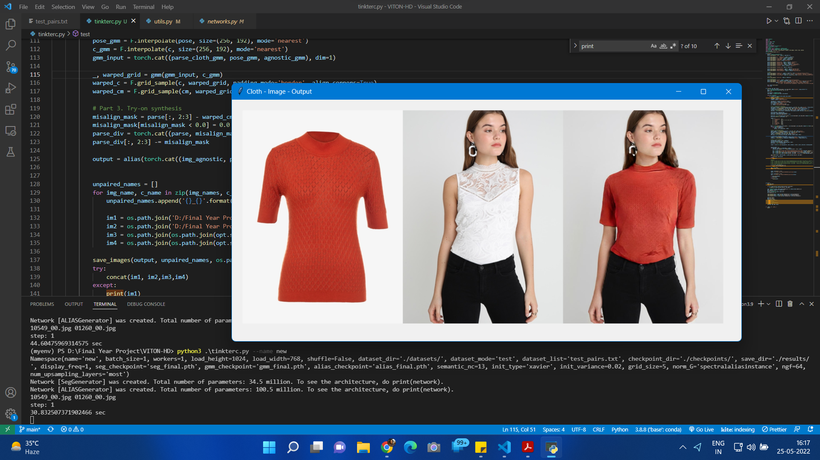

Slide 15
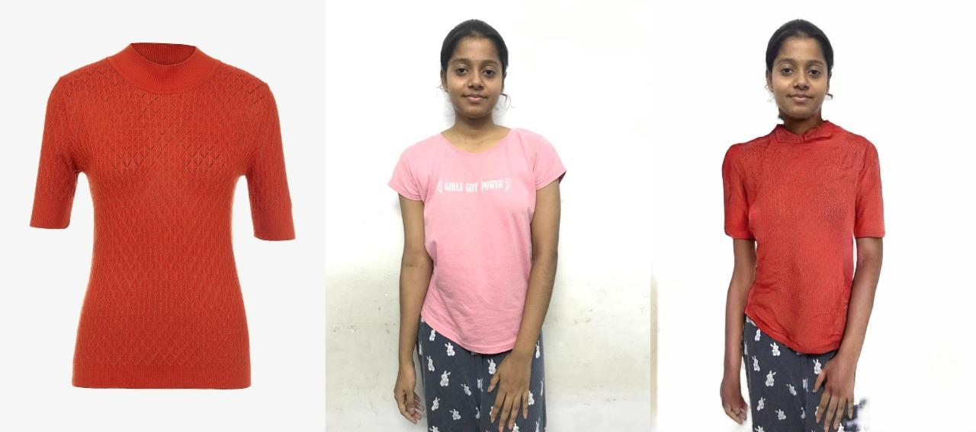
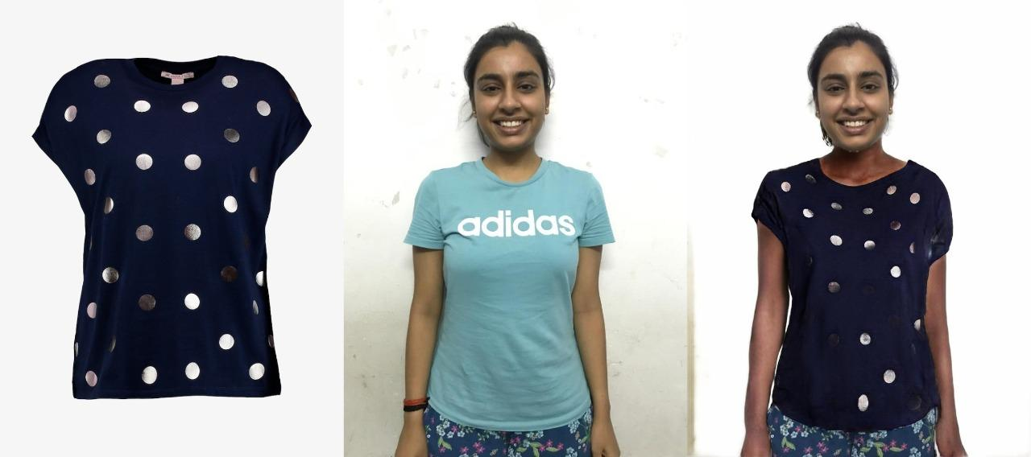

Slide 16
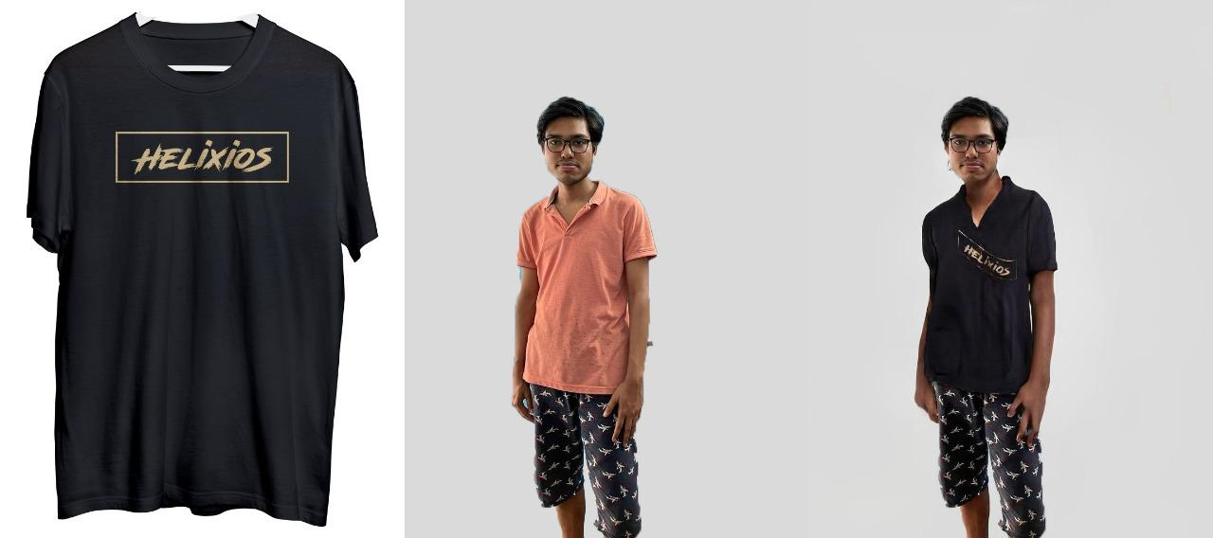

Slide 17
Applications
We propose this model to be fitted in a system and which can be installed in shopping complexes. The system would allow people to capture their pictures through a camera and select the clothing they wish to try from a screen instead of wearing them.
This would save the time they usually spend in changing clothing items.
Also, in the future, this model could replace shopping complexes, as the different brands could instead just set up these systems that would showcase all their clothing pieces. The customer would use it to select their choice of clothing and make purchases.

Slide 18
Limitations
This model is unable to visualise bottom wear apparels on to the reference image.
The execution time for current model starting from pre processing of raw image to final visualisation is up for improvement.
The current GUI is very basic and does not offer the feature to select the clothing item of choice from given options.

Slide 19
Conclusion
As we have approached the end of the project, we can successfully wrap the images of clothing garments onto the target person's body by deforming it following the client's body shape and posture, thereby aiding the customer to visualize the attire's fitting virtually.
To synthesize the photo-realistically, we have used the Attire Fit-In for the virtual try-on. The ALIAS generator help normalize and process staggered areas, propagate semantic information throughout the ALIAS generator, and retain clothing details through multiscale improvements.

Slide 20
References
Seunghwan Choi, Sunghyun Park, Minsoo Lee, Jaegul Choo. VITON-HD: High-Resolution Virtual Try-On via Misalignment-Aware Normalization. In Computer Vision and Pattern Recognition (cs.CV) and accepted to CVPR 2021.
Bochao Wang, Huabin Zheng, Xiaodan Liang, Yimin Chen, Liang Lin, and Meng Yang. Toward Characteristic-Preserving Image-based Virtual Try-On Network. In Computer Vision and Pattern Recognition (cs.CV) and accepted by ECCV 2018.
Olaf Ronneberger, Philipp Fischer, and Thomas Brox, U-Net: Convolutional Networks for Biomedical Image Segmentation. Part of the Lecture Notes in Computer Science book series (LNIP,volume 9351)
Sergey Ioffe and Christian Szegedy. Batch normalization: Accelerating deep network training by reducing internal co-variate shift. In Proc. the International Conference on Machine Learning (ICML), pages 448–456, 2015.

Slide 21
Thank You

